Slide 1

SSNAP Dataset Changes 2024
Community and Six-month assessment

Slide 2





Contents
1. Background
2. Timeline of dataset changes
3. Changes to community dataset
4. Changes to six-month assessment dataset
5. Next steps

Slide 3
Background

Slide 4

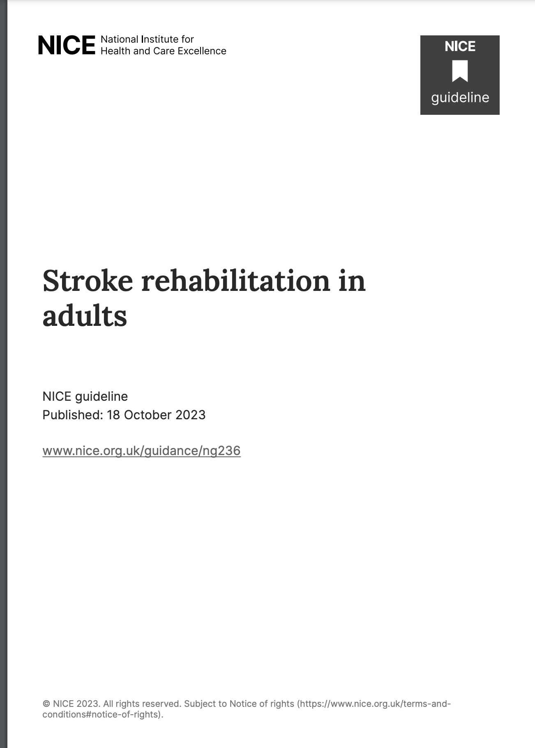
https://www.strokeguideline.org/
https://www.nice.org.uk/guidance/NG236

Slide 5
Timeline of dataset changes

Slide 6
What has happened so far..
April 2023
May 2023
June 2023
July 2023
August 2023
September 2023
October 2023
November 2023
December 2023
January 2024
National Clinical Guideline for Stroke 2023 published
Piloting of dataset begins
Piloting of dataset ends
Dataset finalised
Communicate dataset changes to users
Webinar: dataset changes
Review of dataset begins
NICE rehab guidelines published

Slide 7
Coming up..
February
2024
March
2024
April
2024
May
2024
June
2024
July
2024
August
2024
September
2024
October 2024
November 2024
Webinar: data entry
User webtool testing
Dataset changes live
Data-locking deadline
(July-September/April-September)
Webinar: changes to measures and reporting
December 2024
January 2025
February 2025
March
2025
April
2025
May
2025
June
2025
July
2025
Data-locking deadline
(January-March/October-March)
Results publicly available
Results to teams
Results to teams
Results publicly available

Slide 8
Changes to community dataset

Slide 9
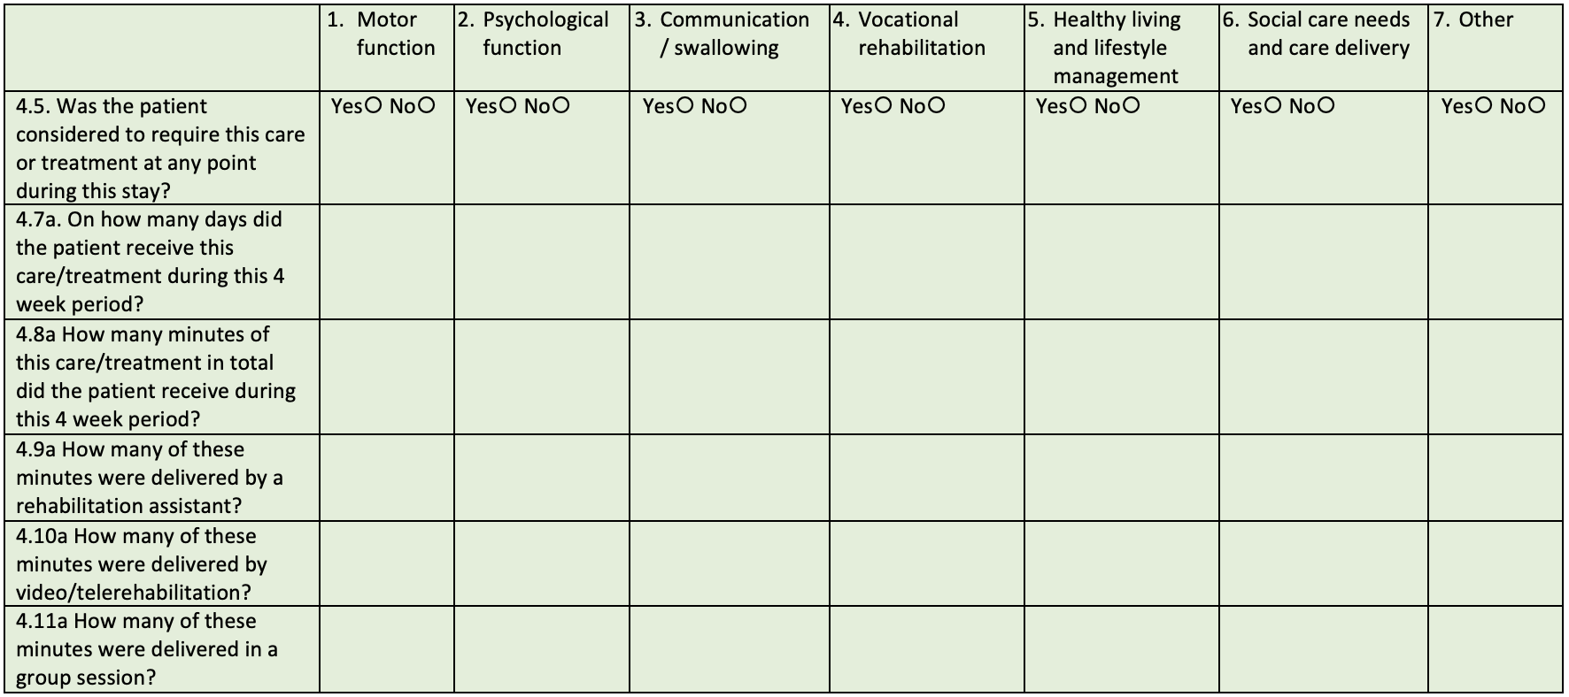
Rehabilitation
Focus on type of therapy/care
End date for each therapy removed. Common end date for all therapies.

Slide 10

Rehabilitation
Therapy includes:
assessment and goal-directed therapy (i.e., towards goals that have been set and agreed by the team)
either individual or group therapy
home visits where the patient is present
training patients and carers around issues related to a specific patient (i.e. not general training)
setting up, supporting and advancing self-directed exercise programmes (independent practice not included)
Semi-supervised practice (such as in open gyms with oversight and interaction with practitioner)
Care includes:
assessment (of patients and carers)
advice and support (with patients and carers)
assessment, trials and evaluation of home adaptation
training of care staff
Please note: telerehabilitation includes synchronous practice only:
In this definition therapy does not include:
documentation
environmental visits
multidisciplinary team meetings
case conferences/case reviews (where patient is not present)
development of resources (where patient is not present)
independent practice

Slide 11
Rehabilitation
Please attribute minutes to the category that best describes the main focus of that therapeutic session, or part of a session. Where there is more than one focus to a single session then minutes would be apportioned for each part and added up under each category appropriately. Please do not count the same minutes under more than one category, and do not double-count within the same category
For example:
If a therapist works on two different categories of rehabilitation during a 60-minute session, record the number of minutes for each category (e.g. 30 minutes for motor function, 30 minutes for communication). Please refer to patient notes to accurately determine the split per each.
If two therapists (of different disciplines or the same discipline) treat a patient at the same time, focused on the same category of rehabilitation, record the number of minutes of therapy the patient received e.g. 2 therapists providing rehabilitation for motor function to a patient for 45 minutes counts as 45 minutes of motor function therapy (not 90 minutes), therefore recording how many minutes the patient received rather than recording the time therapy staff spent providing the session.
Where a 60-minute session has required two members of staff and one is qualified and one is an assistant and they are both providing the same category of rehabilitation, assume the session has been led by the qualified therapist, record 60 minutes of therapy received by the patient as qualified and do not record any minutes as assistant provided. (i.e., do not split minutes across staff groups), therefore recording how many minutes the patient received rather than recording the time therapy staff spent providing the session.
The therapy or care may be provided by registered therapists of any discipline or non-registered therapy staff, including rehabilitation assistants or students, under supervision.

Slide 12
Rehabilitation: Motor function
Please note ‘motor function’ does not cover all aspects of motor-based rehabilitation, but captures exercise, strength and activity related to sitting, standing, upper limb, gait and balance.
Includes:
Repetitive task practice
Functional tasks with a therapeutic approach to improve motor function i.e. improve standing tolerance, dynamic balance, trunk control (midline), reach to grasp in a task
Mobility practice, real world walking
Progressive balance training
Treadmill training
Strength training
Trunk/Sitting balance work
Sensory retraining
Functional Electrical Stimulation
Mirror therapy
Constrained Induced movement therapy
Mental imagery
Spasticity management
Exercise targeted at motor recovery including sensorimotor, strength or coordination
Home visits from an inpatient setting where primary focus was physical abilities
Further assessment specifically aimed at motor function
Outcome measures specifically aimed at motor function (i.e. not holistic outcome measures required by SSNAP e.g., Barthel which are captured in ‘other’)
Does not include independent practice; wandering between therapy sessions or as part of normal daily living (such as to and from the toilet); sitting out; normal daily eating and drinking; splint wearing. Exercise for cardiovascular fitness should not be included. This does not include initial assessment (include in Other).

Slide 13
Rehabilitation: Psychological function
Includes:
Cognitive assessment
Perceptual assessment
Mood assessment
Assessment of/intervention for cognitive communication disorder
Level 1,2 or 3 psychological support including;
  Low level interventions such as supportive conversations, goal setting, relaxation methods such as tai chi
  Psychoeducation (specific to individual patient)
  Psychological interventions e.g. Motivational interview, Cognitive Behavioural Therapy, Acceptance + Commitment Therapy, anxiety management.
  Impairment based training e.g. attention work, memory training, insight work, Inattention training
Fatigue management including patient education (specific to individual patient)
Functional tasks focussed on assessment of/improvement of functional impact of cognitive/perceptual impairments- i.e. improvement in sequencing, planning, object use, problem solving, self-monitoring and self-awareness, risk management, apraxia, agnosia, neglect. This may include assessment of functional tasks such as multiple errands, road crossing, money management, driving
Functional tasks focussed on mood e.g. meaningful activity, anxiety management, self-care
Capacity assessment (where the predominant reason for assessing capacity is due to cognitive or mood issues)
Training the patient in the use of phones, emails etc for the purpose of communicating with others where the approach is related to cognitive deficits i.e. learning, memory, attention, navigation of device
Home visits from an inpatient setting where primary focus was cognitive abilities
Does not include report writing or activity pertaining to work which is not patient facing such as MDT formulation or education of staff. Does not include obtaining social history, initial assessments or discharge discussions

Slide 14
Rehabilitation: Communication/swallowing
Includes:
Assessment, intervention and education for aphasia including Comprehensive Aphasia Training (virtual or in person)
Communication and intelligibility techniques for dysarthria
Dysphagia training- inc. PES
Motor exercises for facial weakness or dysarthria
Motor training techniques for apraxia of speech
Reading, writing, speech, numerical work
Assessment for and training with communication aids and assistive devices
Communication partner training
Facilitating communication in important discussions/decisions- including capacity assessment for those with significant aphasia (i.e. where aphasia is the primary issue impacting demonstration of capacity). Where discussions/capacity assessment is carried out by two professionals, enter under psychological only, so not to double count minutes.
Does not include report writing or activity pertaining to work which is not patient facing, such as creation of individualised resources. Does not include initial assessment. Note therapy pertaining to cognitive communication disorders sits within psychological function.

Slide 15
Rehabilitation: Vocational rehabilitation
Includes:
Assessment of potential barriers and facilitators to returning to work including work place assessment
Collaborative development of an action plan, with patient, for how barriers may be overcome
Interventions as required by the individual, which may include vocational counselling and coaching, trialling adaptations or equipment in the workplace, work hardening
Meetings between the person with stroke, their employer and healthcare professional in planning, facilitating and monitoring their return to work
Does not include report writing or activity pertaining to work which is not patient facing, such as organisation of equipment or adaptation, administrative emails/telephone calls.

Slide 16
Rehabilitation: Healthy living and lifestyle management
Incudes assessment, advice or intervention regarding;
Wound management/ skin care
Medications management
Secondary prevention e.g. management and education for blood pressure, lipids, diabetes
Taking physical observations as part of a physiological treatment plan or monitoring plan
Healthy eating
Smoking cessation or alcohol intake
Continence management
Sex and intimacy
Assessment/facilitation to engage in in social/leisure activity
Exercise for cardiovascular fitness
Does not include independent social activity or independent exercise.

Slide 17
Rehabilitation: Social care needs and care delivery
Includes:
Care act assessment
Training of care staff related to individual’s specific needs
Advice, support and assessment regarding housing and benefits
Carer assessment and support
Assessment regarding home adaptation
Delivery of care* I.e., for personal activities of daily living, meal preparation (reablement)
Does not include report writing or activity pertaining to work which is not patient facing, such as brokering for care, meetings regarding care allocation, equipment ordering, administrative emails/telephone calls. Minutes collected under this category can be delivered by any member of the team (ie not limited to social workers)
*Care visits are those that would ordinarily be provided by social care and are not targeted therapy treatment sessions.

Slide 18
Rehabilitation: Other
Includes:
Initial assessment (comprehensive/holistic assessment carried out by stroke specialist professional). Any further domain-specific assessments should go under their relevant therapy/care type, i.e. a cognition assessment should go under psychological function.
SSNAP required outcome measures (EQ5DL, Barthel and mRS). Domain specific outcome measures (not required by SSNAP) should go under the most relevant therapy domain (i.e. balance measures recorded as minutes under motor function).
Visual assessment
Ocular motor and visual field interventions. (Note interventions associated with visual perception and visual neglect are included in psychological domain)
Social History Gathering – with patient (not by proxy)
Discharge planning discussions with patient (not by proxy)
Wheelchair assessment
Wheelchair training
Other patient facing therapeutic activity that is not covered by the categories above but that fit the criteria of therapy.
Does not include report writing or activity pertaining to work which is not patient facing, such as discussions with family, meetings regarding care allocation, equipment ordering, administrative emails/telephone calls.

Slide 19
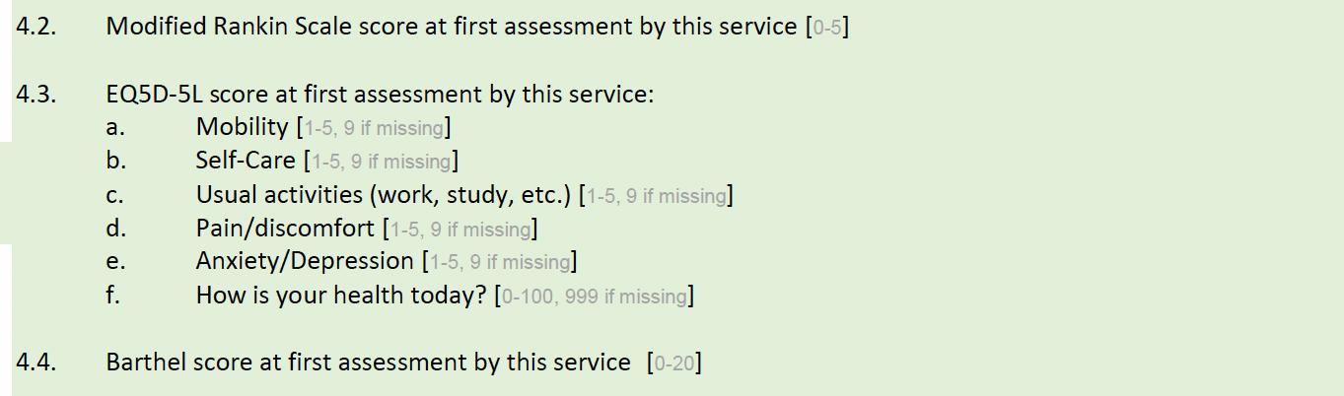
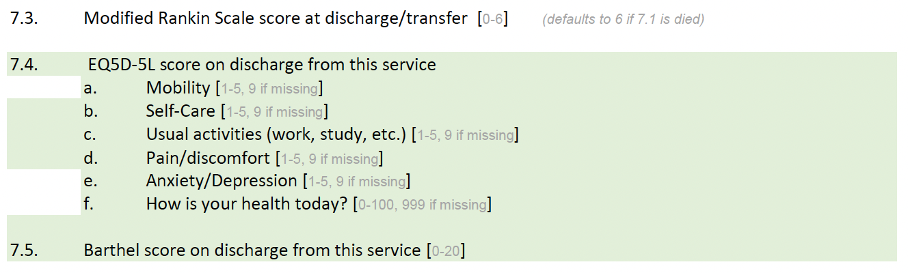
Outcome measures

Slide 20
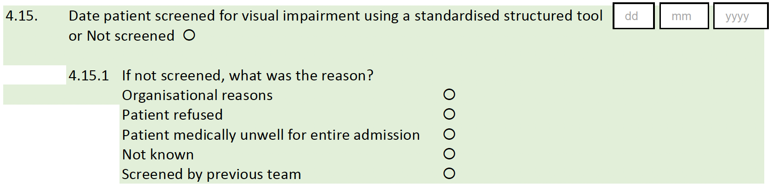
Vision screening

Slide 21
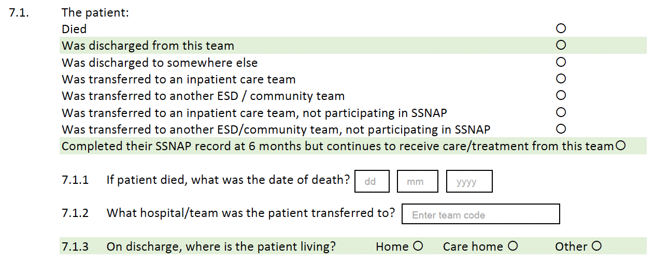
Discharge destination

Slide 22
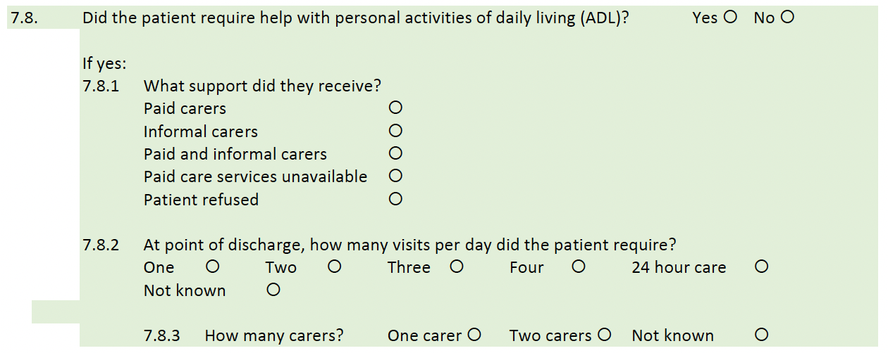
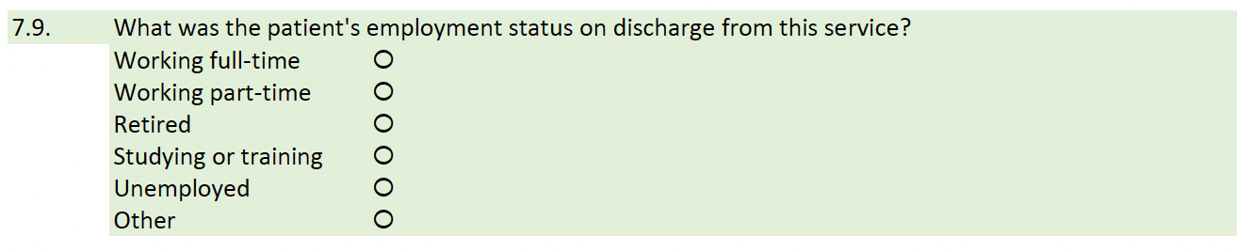
Activities of Daily Living (ADL) and employment status

Slide 23
Changes to six-month assessment dataset

Slide 24
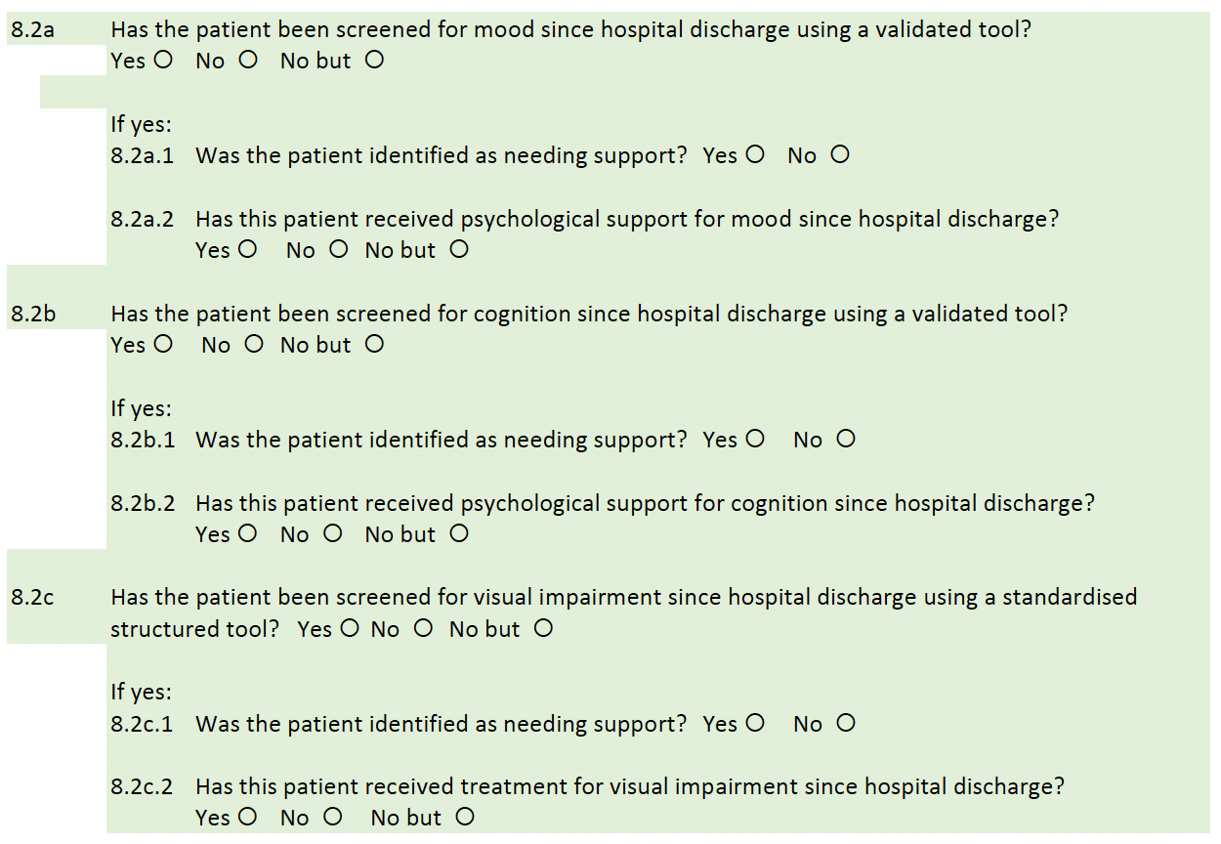
Mood, cognition and vision screening

Slide 25
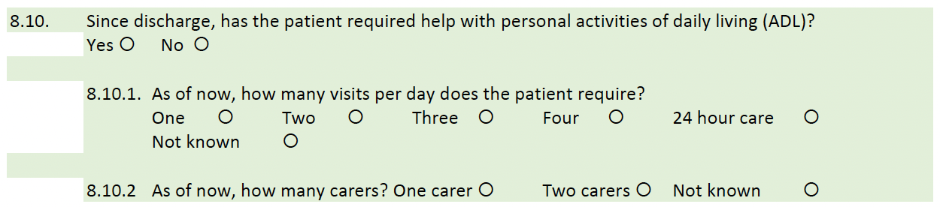
Activities of Daily Living (ADL)

Slide 26
Next steps and Q&A

Slide 27
Thank you
Thank you to all the ambulance trusts, hospitals and community teams for continuing to participate in SSNAP. Their participation and commitment to the audit ensures that quality, rich data is available which can be used to improve stroke services.
Sentinel Stroke National Audit Programme (SSNAP)
ssnap@kcl.ac.uk
www.strokeaudit.org
© 2023 King’s College London. All rights reserved

